Slide 1
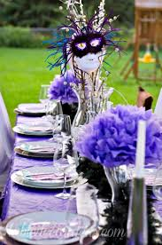
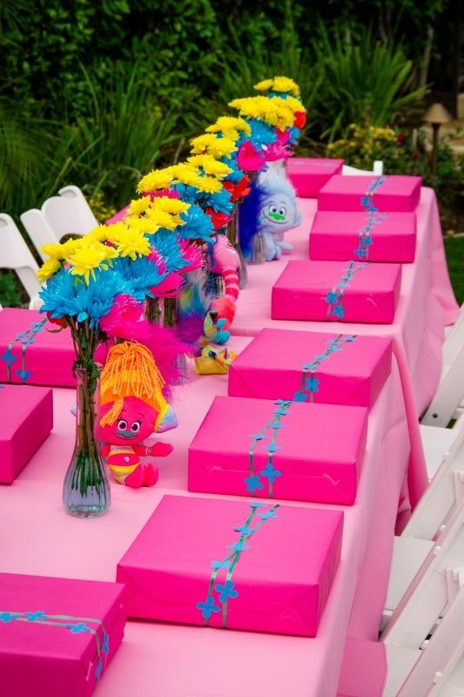
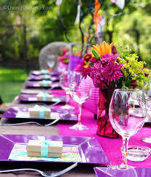
Party Decorations

Slide 2
Reasons for most parties
To celebrate
To impress someone or some group of people
A party giver wants a “good show” of both beauty and service
The atmosphere is what makes a lasting impression at a party

Slide 3
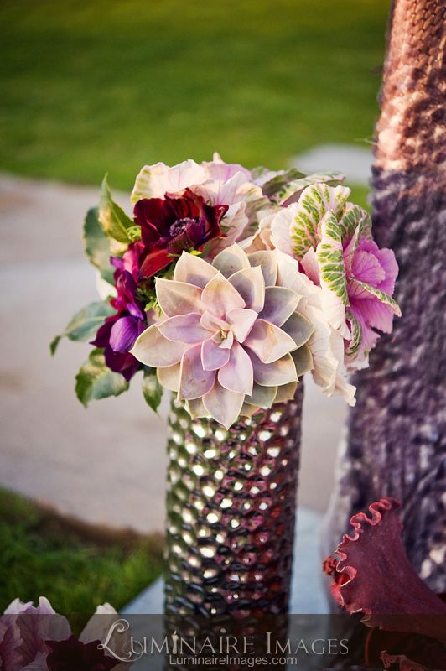
Checklist of Party Planning Designs for a Florist
Occasion?
Location Date/Time
How many guests will attend?
Customer preferences - flowers, lifestyle
Theme (casual or formal)
Color scheme of the room or surroundings
Existing lighting - will special lighting be needed
Are the use of candles allowed?
How long will the flowers have to last?
Does the customer have containers, accessories or props that need to be incoporated into the table?

Slide 4
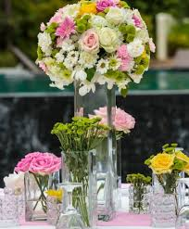
How to Price for the Party Designs
List each item that is needed
List softgoods/hardgoods and their cost
Allow leeway for changes in flower prices and availability
Include labor costs, rental prop cost
Include on-site set up labor cost if the party is large

Slide 5
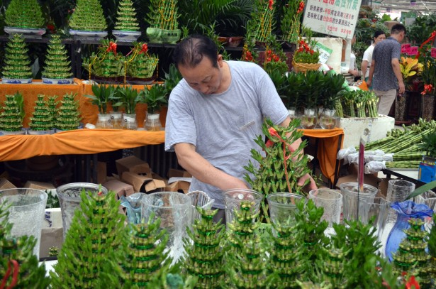
3 Ways to Express Markup Charges
Percentage
Times the cost (example - 2X the cost of the item)
Ratio
How to calculate labor - increase the markup OR price out and add a percentage OR a charge a certain amount per hour

Slide 6
Assignment - Due when you come to class Thurs.
On the opposite side of your notes in your notebook - you are to sketch an idea for a party design table.
Requirements -
1) Include 1-3 floral arrangements on your party table. (ex. 1 large centerpiece & 2 small or 2-3 medium sized designs)
2) List the flowers/foliages you would use
3) Show any accessories, food items, etc you would have on the table
4) You MUST color the sketch to show the theme/color scheme

Slide 7
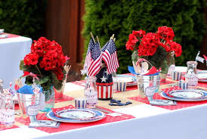
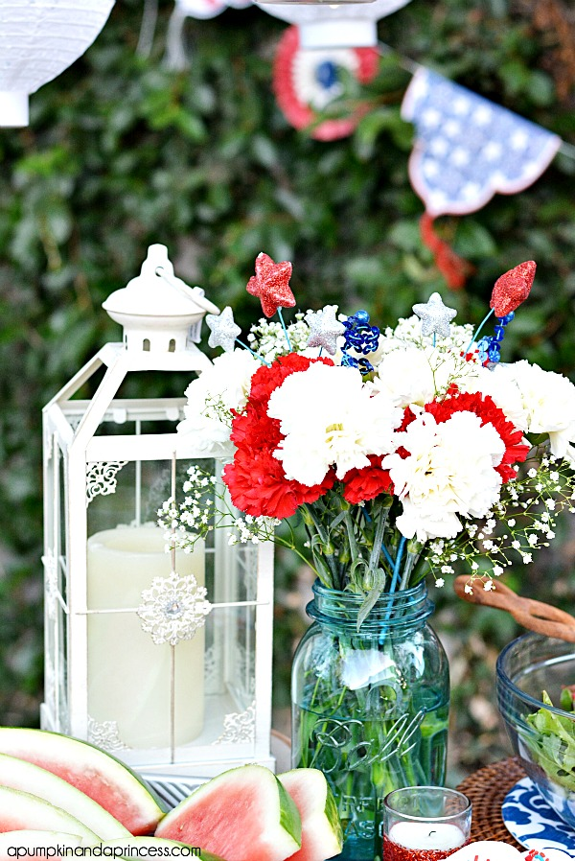
Example
Red standard carnations with white daisies
Flags
Tin containers
White lanterns
Placemats
Matching plates, utensils, clear mugs with themed straws
White table covering
Candles in votives (small glass jars)
Incorporate summer type food such as watermelon, berries

